Slide 1
Data Warehousing Concepts
Subject-oriented Data
Integrated Data
Time-variant Data:
Data in the warehouse is only accurate and valid at some point in time or over some time interval.
Non-volatile Data:
Not updated real-time, but refreshed periodically (daily or weekly)
However, faster systems enables frequent updates.
New data is added as a supplement to the database, rather than a replacement.
Notes:
Benefit: high returns on large investments to implement data warehouse. (ROI > 400%)

Slide 2
Online Transaction Processing (OLTP) System Focus on operations
To improve the process of moving data around to handle day-to-day affairs
Scheduling classes,
Registering students,
Tracking benefits,
Recording payments, etc.
Optimized for
Concurrent access
Large number of simple transactions
Typically use RDBMS at the back-end

Slide 3
Table 32.1: OLTP vs. Data Warehousing
Characteristic | OLTP | Data Warehousing
How many? | multiple in an organization | one
Main purpose | operational processing | analytical processing
Data Age | current | Historic (recent)
Data latency | real-time | periodic to real-time
Data granularity | detailed | detailed + summarized
Data processing | Predictable, high throughout | less predictable pattern
Reporting | static fixed format | multidimensional + dynamic
Users | many operational users | managerial users
Often with repeated data across tables

Slide 4
Data Mart
A data mart is a repository of data enabling users to retrieve information for single departments or subjects, improving the user response time. Because data marts catalog specific data, they often require less space than enterprise data warehouses, making them easier to search and cheaper to run.
To provide data in a form that matches the collective view of the data by a group of users in a department or business application area.
To provide appropriately structured data as dictated by the requirements of end-user access tools.

Slide 5
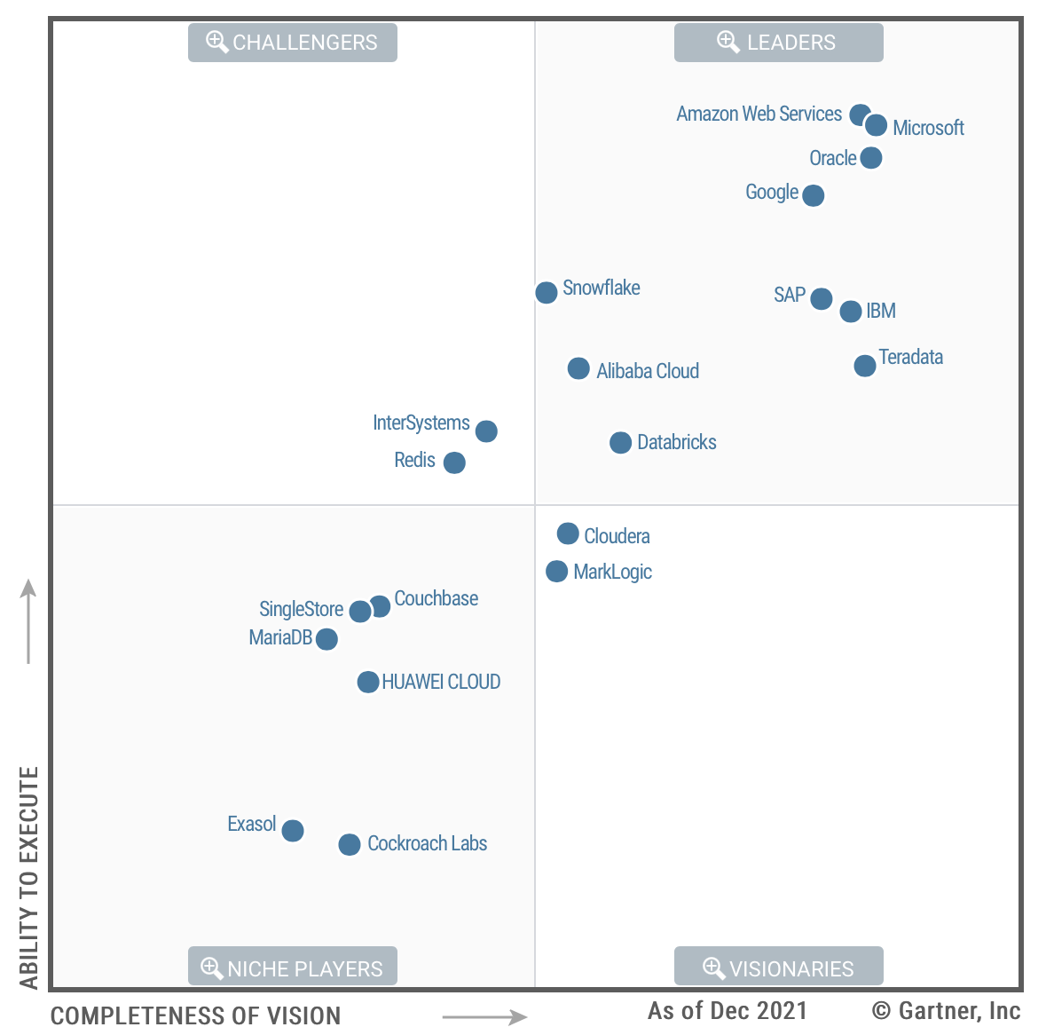
Gartner Magic Quadrant for Cloud Database Management Systems

